Slide 1
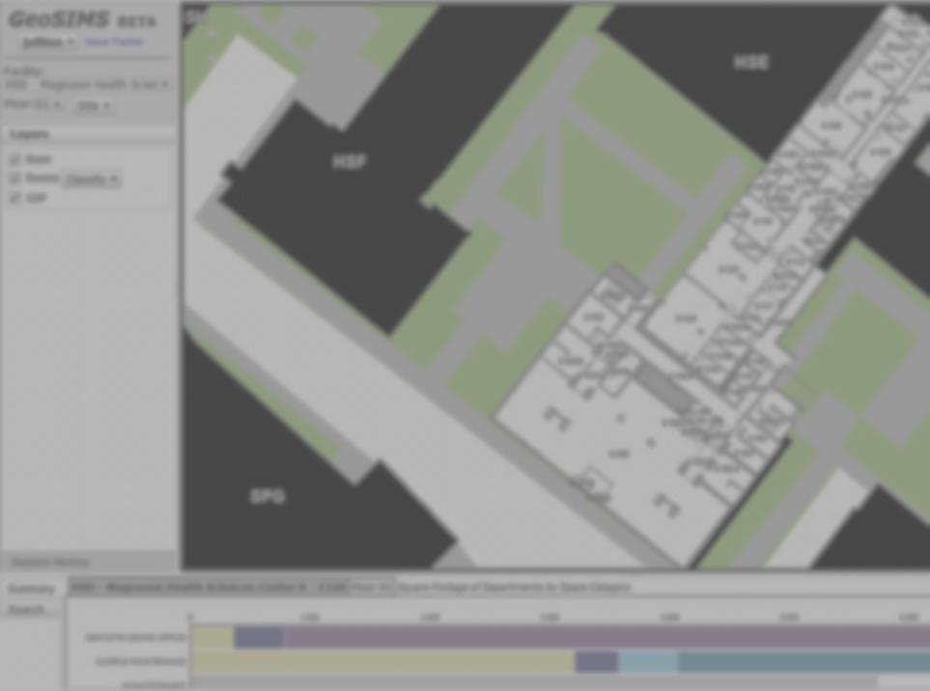
GeoSIMS:
University of Washington
Floor Plan GIS

Slide 2
Why GIS for Floor Plans?
Space is a resource:
Governmental & institutional requirements for records, reporting, analysis and planning
Efficient management of space
After our people, space is our most valuable asset

Slide 3
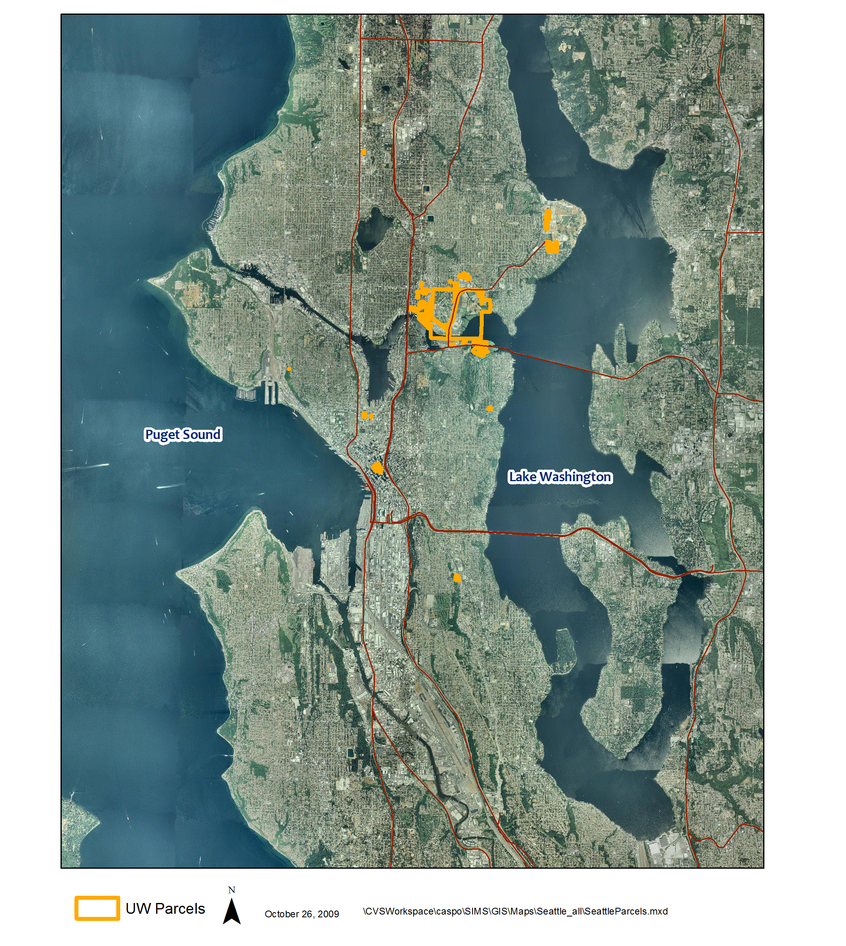
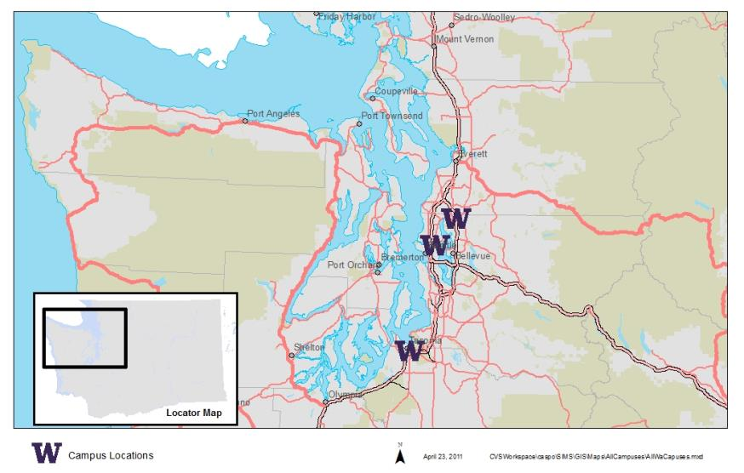
The University—Seattle

Slide 4
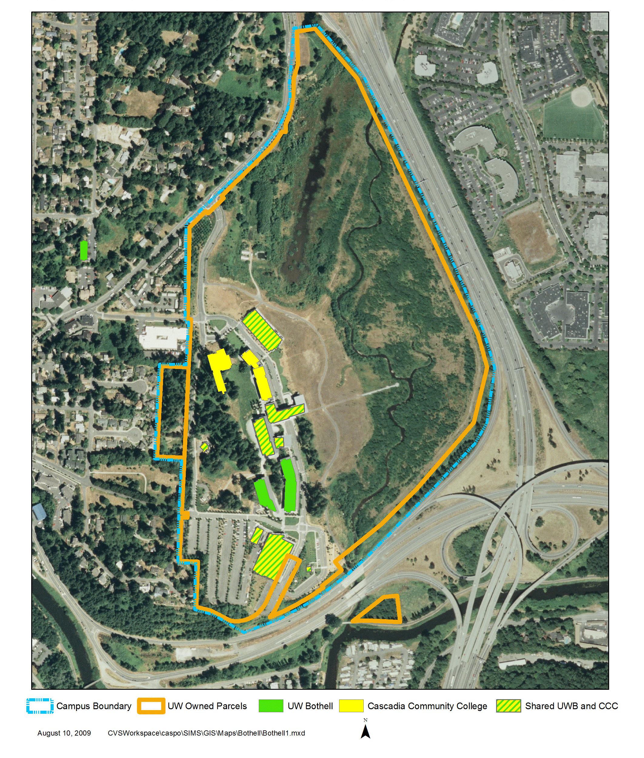
The University—Bothell

Slide 5
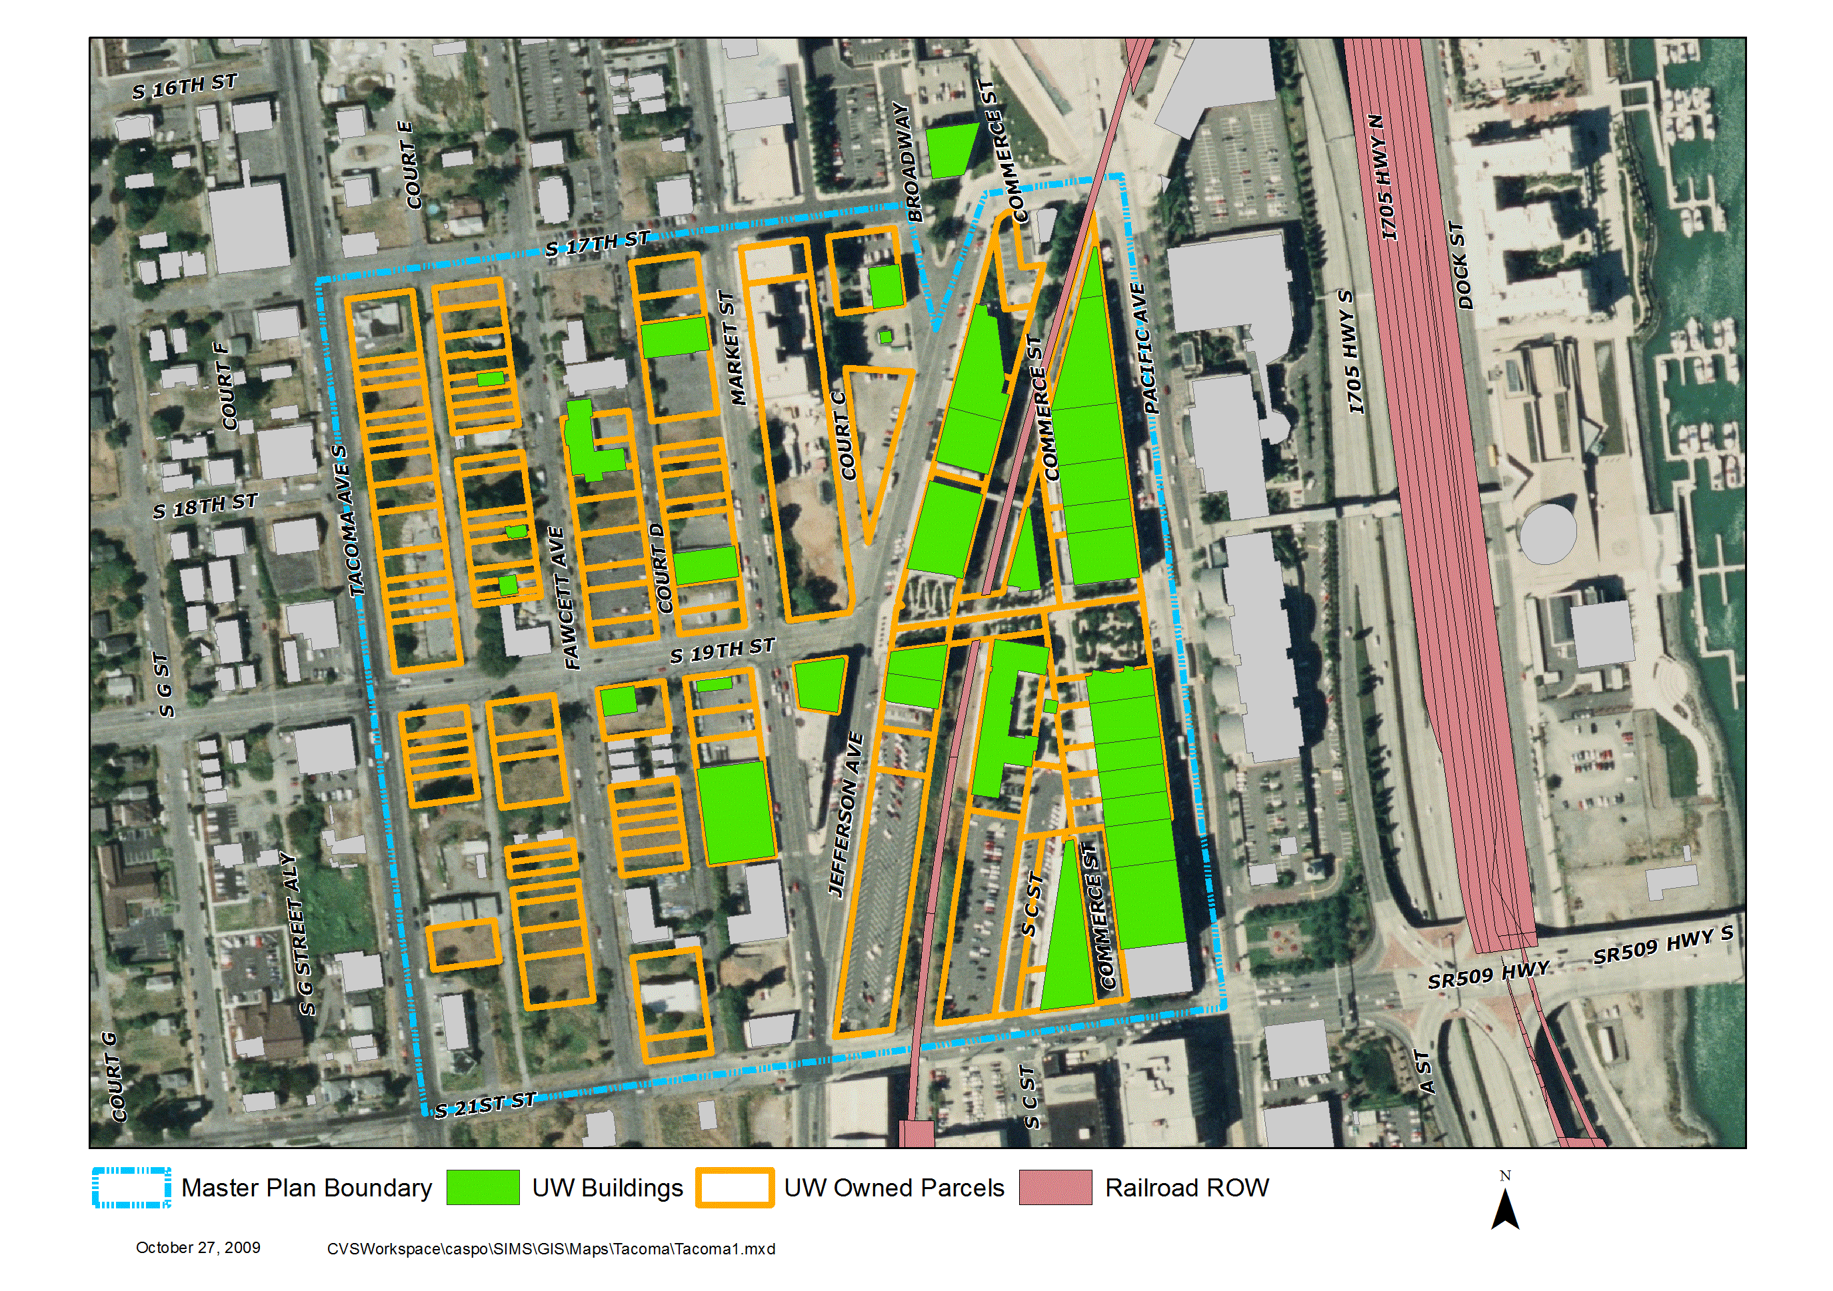
The University—Tacoma

Slide 6
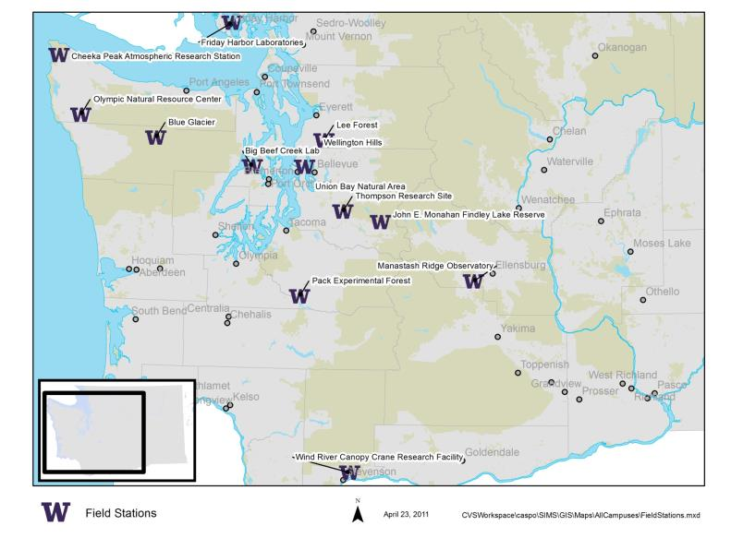
The University—Washington Field Stations

Slide 7
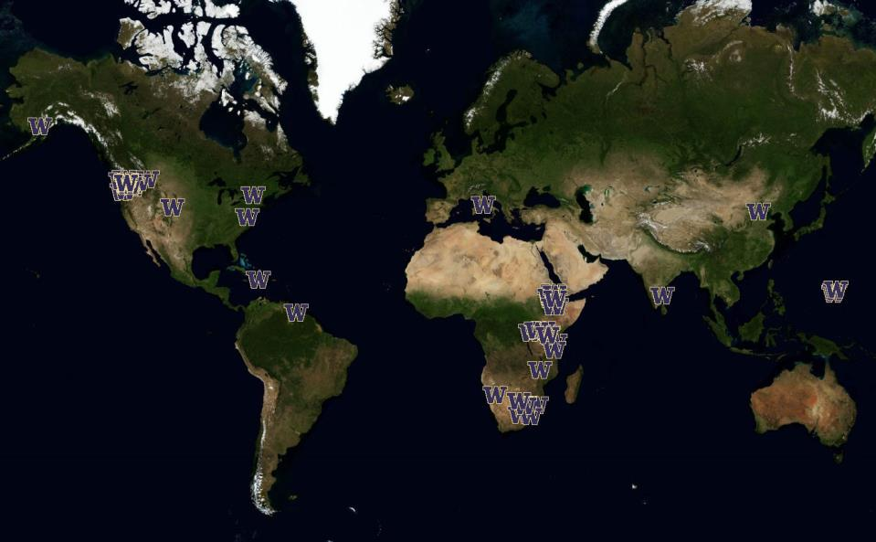
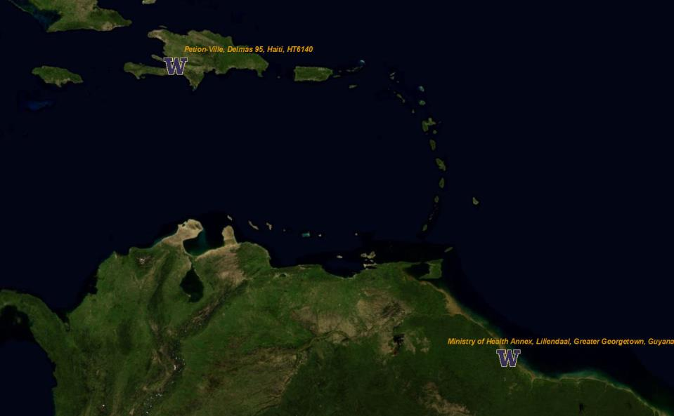
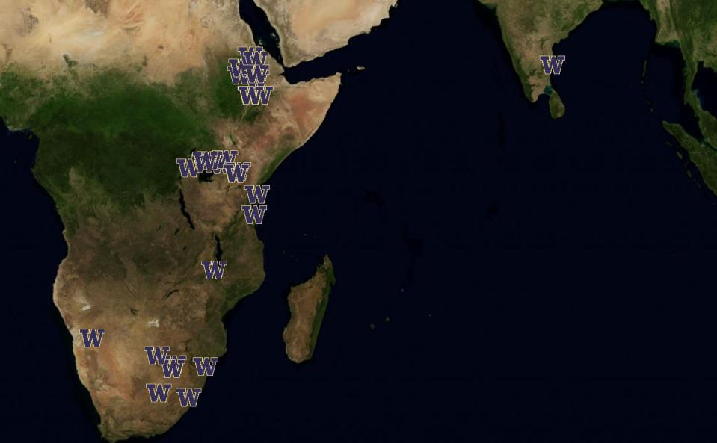
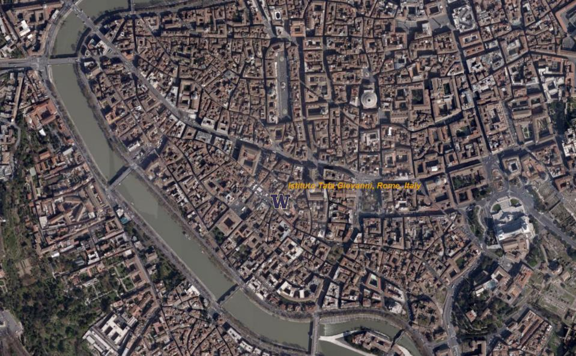
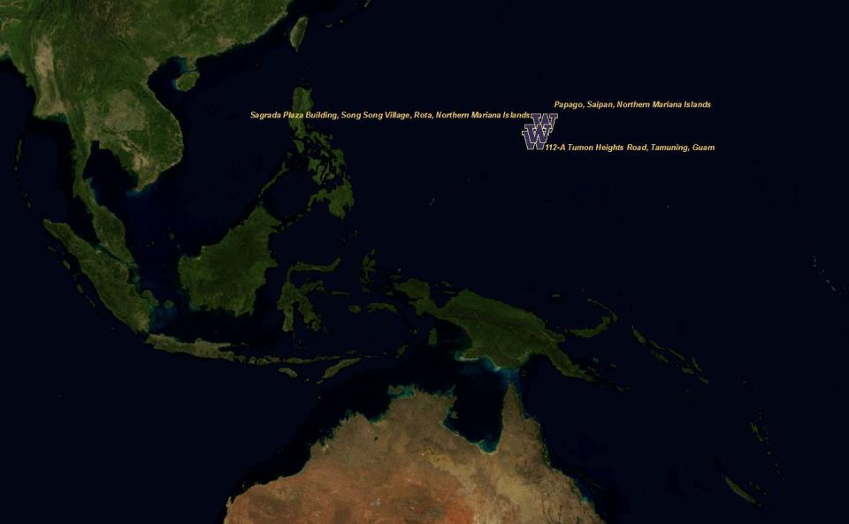
The University—Worldwide

Slide 8
Floor Plan Geometry
What does this mean for the UW Data?
~700 Buildings, >300 with floor plans
~1,600 Floors (a single CAD floor plan for each)
> 66,000 rooms
> 21,000,000 square feet of space

Slide 9
What is Being Revised
Map Interface Web Application (SIMS→GeoSIMS)
Stand-Alone Data Interface (SIMS→GeoSIMS)
Reports (SIMS→DSS)
Database Tweaks (For the most part, not visible to SIMS users)

Slide 10
Geometry Requirements
In developing the floor plan GIS, we had these needs:
CAD will be the source for GIS
Must maintain CAD and GIS geometry simultaneously (Generally, engineers and architects wanted CAD, planners wanted GIS)
Geometry is the source for room #s and square feet
Each data theme (Rooms, GSF, Lines) will have all buildings in a single layer (for queries)

Slide 11
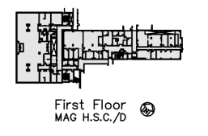
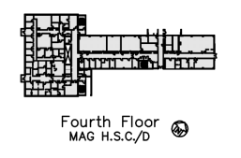
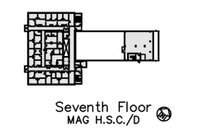
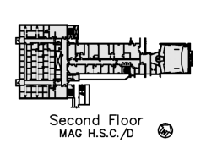
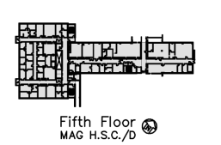
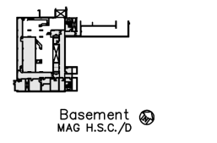
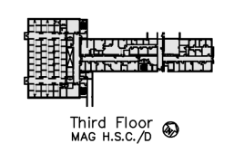
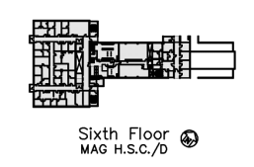
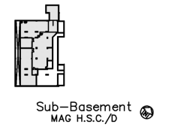
Georeferencing

Slide 12
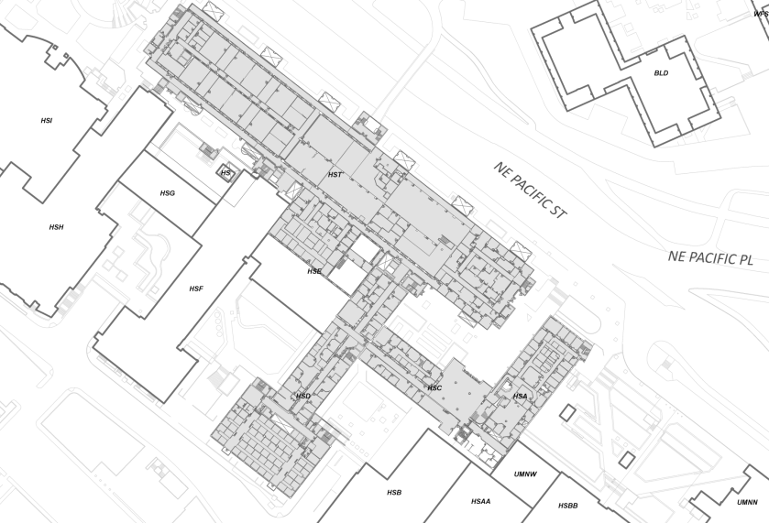
Georeferencing

Slide 13
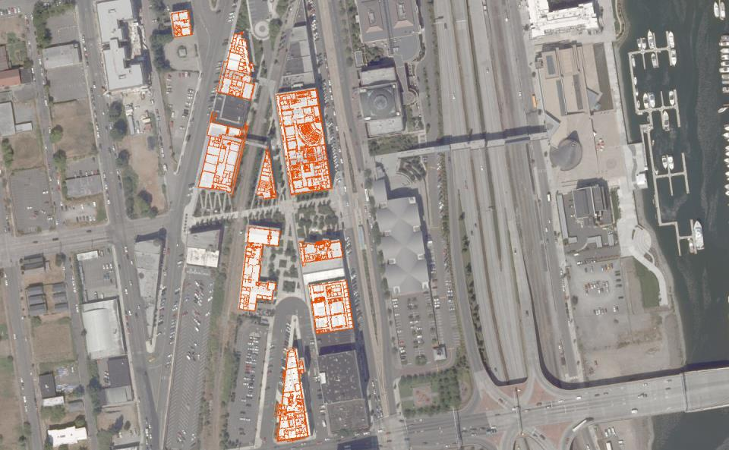
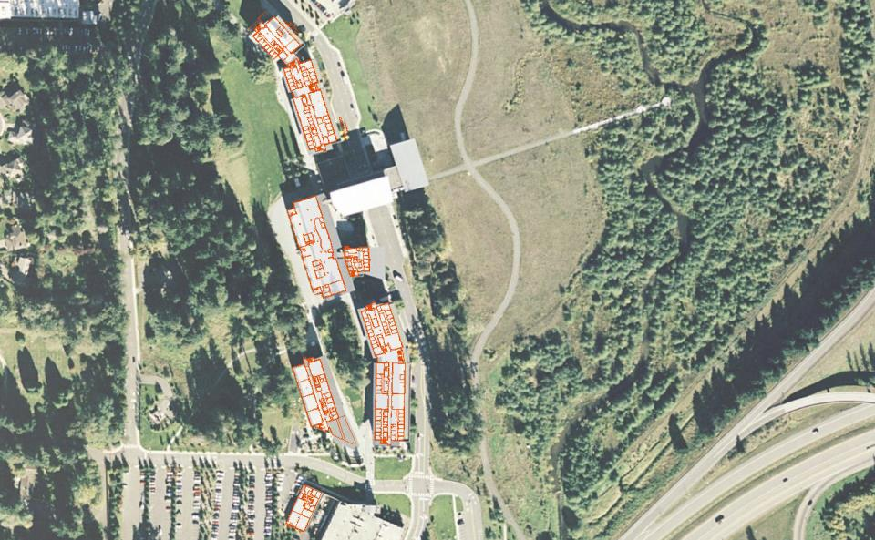
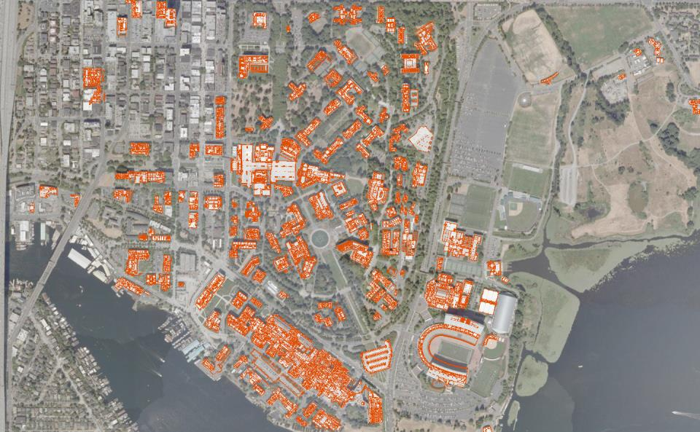
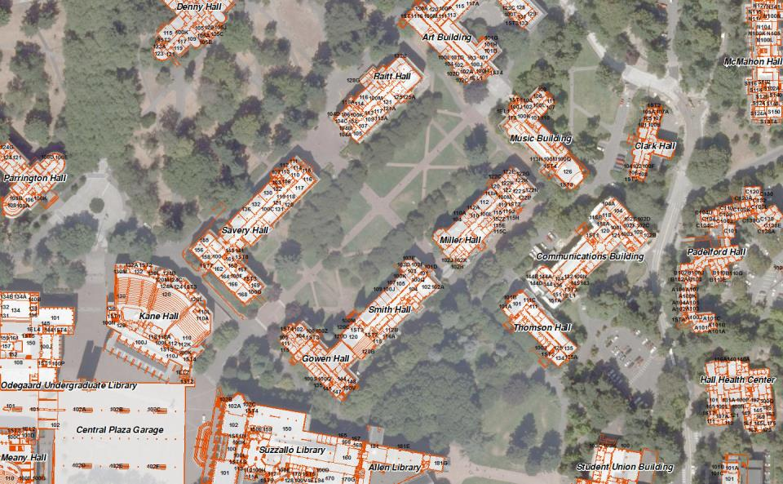
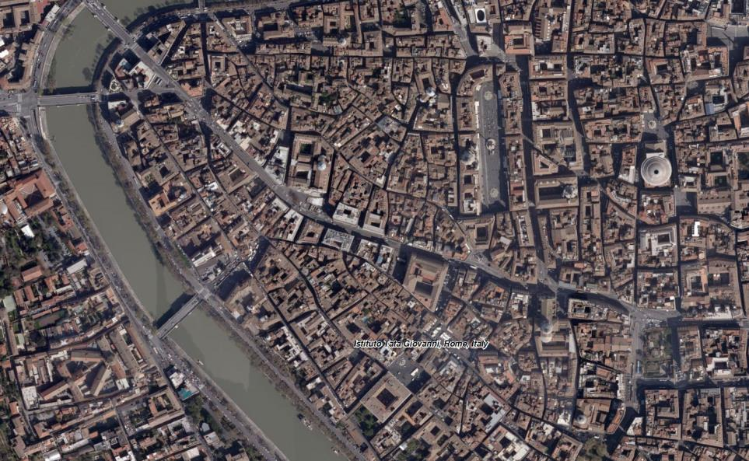
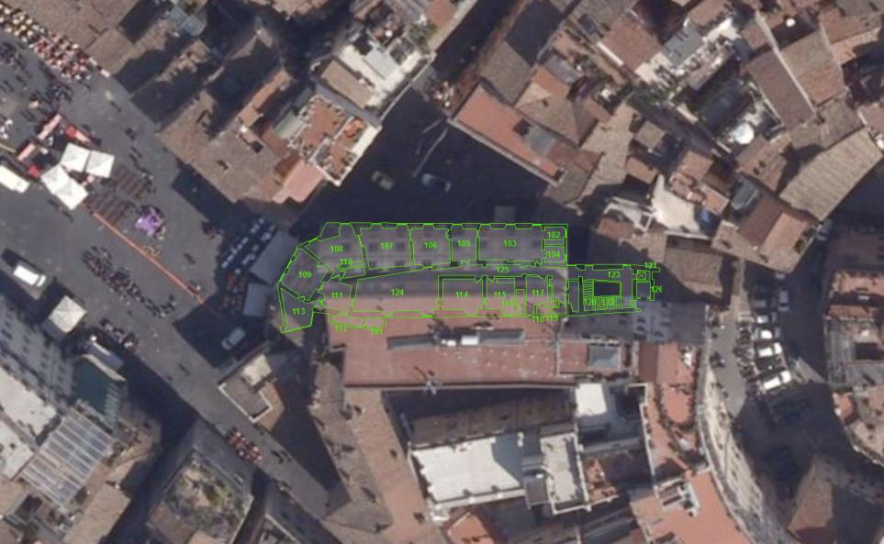
Final Product

Slide 14
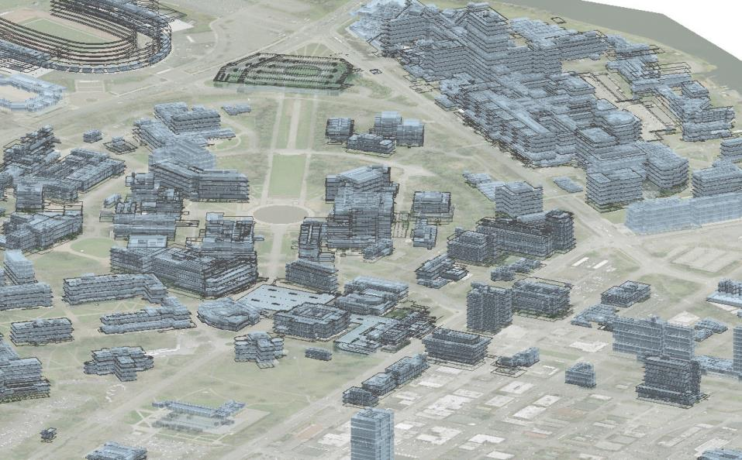
Applications

Slide 15
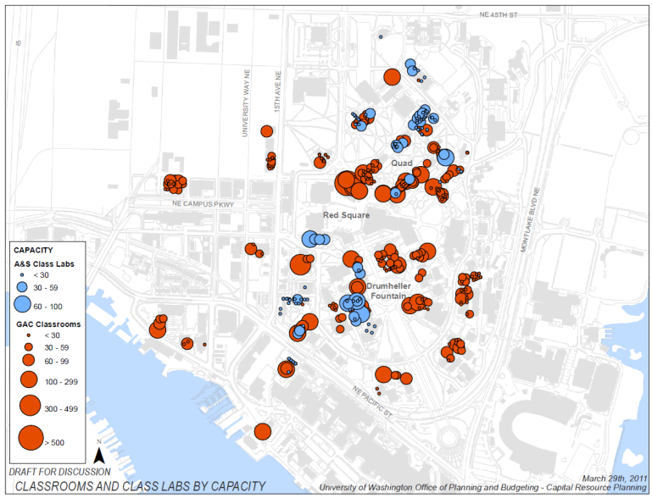
Spatial Distribution

Slide 16
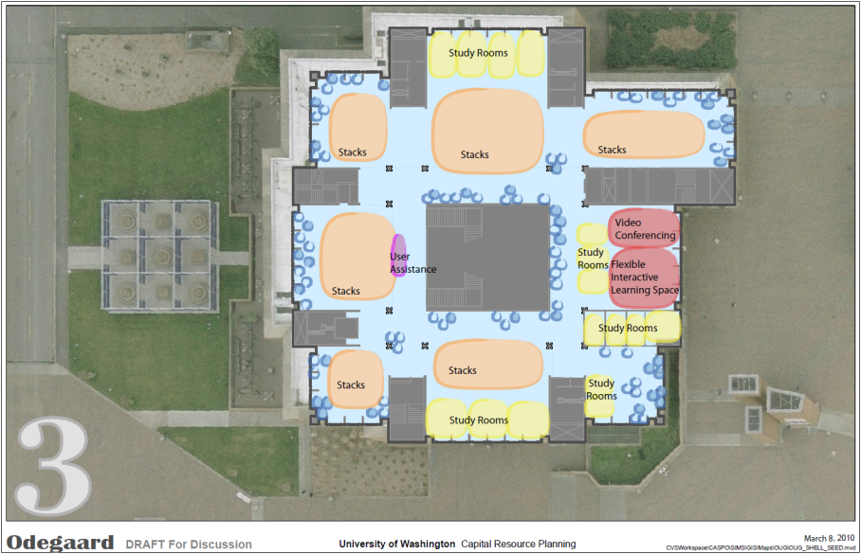
Pre-design Planning

Slide 17
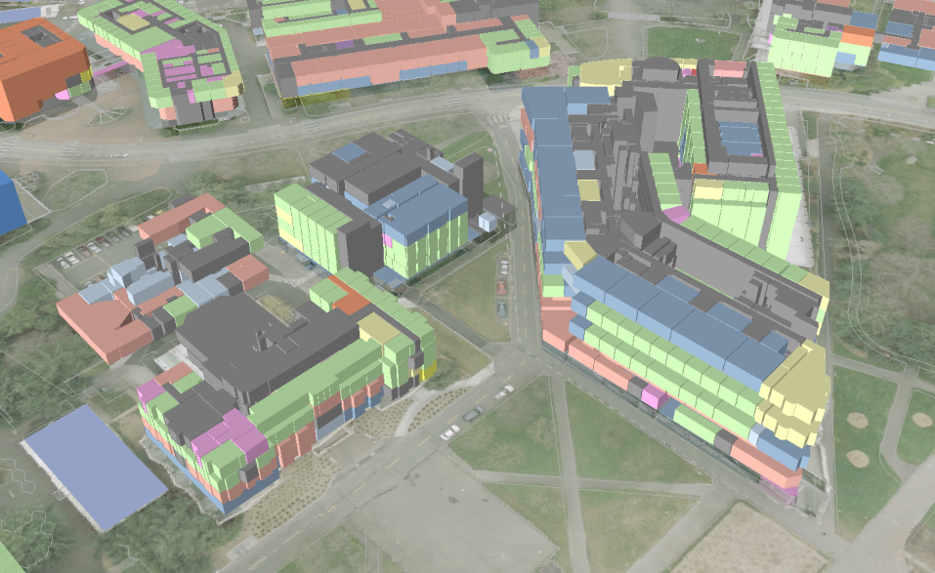
3D Modeling

Slide 18
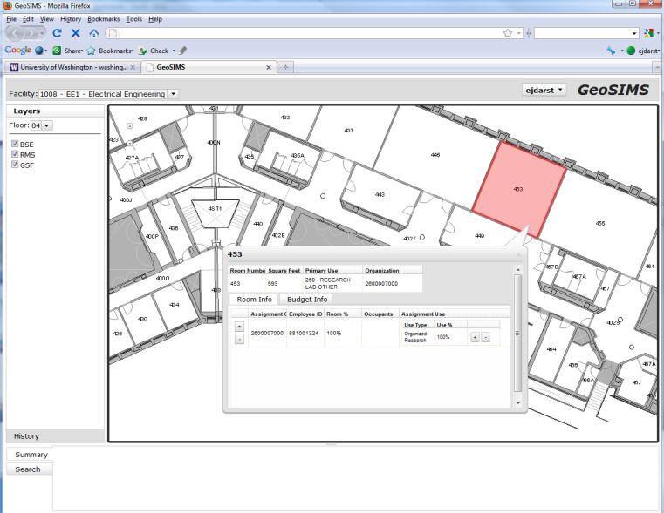
Space Inventory Web App

Slide 19
Questions?
Jeffrey Linn
jefflinn@uw.edu
Eric Darst
ejdarst@uw.edu
http://www.washington.edu/admin/pb/home/

